Slide 1


COMPANY PRESENTATION

Slide 2

Content
COMPANY Presentation
01.
02.
03.
04.
Presentation of PROGRESS-IT
Global information and my integration
My tasks
Describe my tasks
Hierarchy
Conclusion

Slide 3
Progress-IT
COMPANY Presentation
Specialises in consulting, implementation and management of digital and organizational projects
2015
200K
12
employees
Founded in
Turnover 2020
9 permanents positions
3 interns.

Slide 4
COMPANY Presentation
Values
Passion
Excellence
Discover new fields
Use new technologies/ processes.
Customer satisfaction Respect for commitments Surpass ourselves
Agility
Sharing
Adapt our operations/methods/processes for customers.
Share our experiences/ideas, /achievements/sticking points

Slide 5



FamilyBOOK
COMPANY Presentation
VAGABOND Presentation
Page 5
Simplified video calls & photo sharing,
Message sending
the way to maintain the family bond, simply, in a friendly, attractive and economical way.

Slide 6
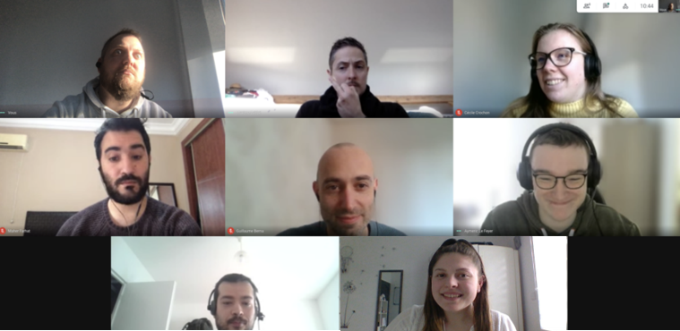
Beginning My internship
COMPANY Presentation
Page 6
9
th
Meeting
During the lockdown
November
— 01.

Slide 7

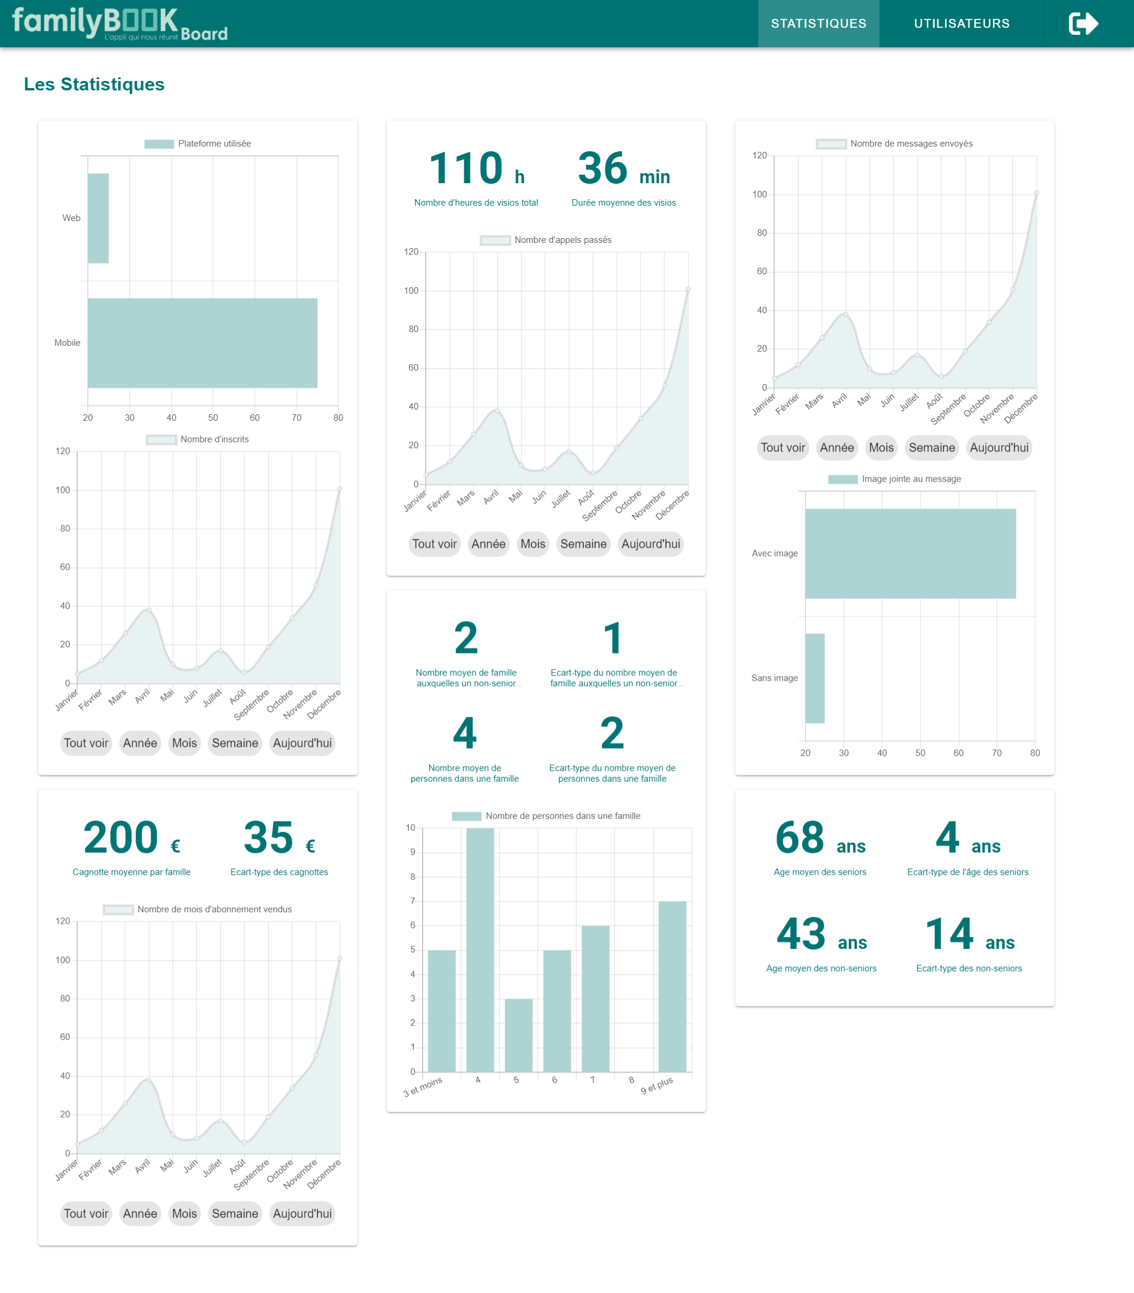
My tasks
COMPANY Presentation
A dashboard
Monitoring
Performances

Slide 8

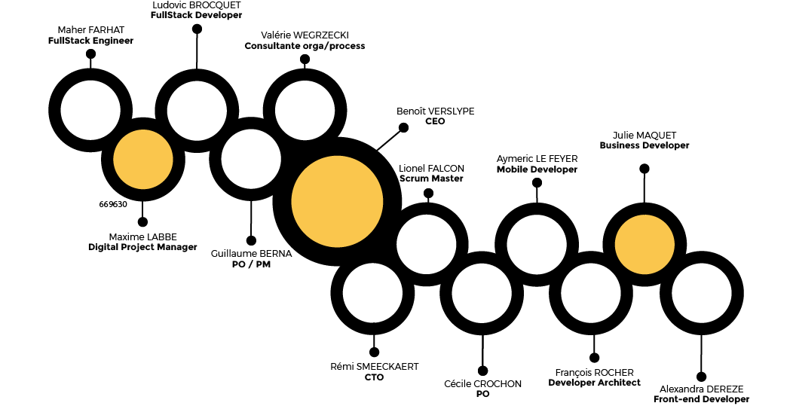
Hierarchy Progress-IT
COMPANY Presentation
Page 8
organ process consultant
software architect

Slide 9


Conclusion
COMPANY Presentation
VAGABOND Presentation
Page 9
This internship confirms my choice to progress in the IT fields.
I would like to work as a developer in the future.

